Slide 1
Comparing Federal Disaster Relief and County Household Income
By: Ryan Klueg, Muhamat A. Ibrahim Oumar, Evan Kamis, Chun (Frankie) Wong

Slide 2
Premise
Is there a correlation between the Median Household Income in a county and the amount of Money in Disaster Relief it will receive from FEMA?
And are certain disaster types more expensive?

Slide 3
Our Data Sets
FEMA’s Public Assistance Funded Projects Summaries - V1 API
The Census’s SAPIE program data
There was minimal change over in median household income over the past 15 years and non decienial data are estimates.

Slide 4
FEMA
Federal Emergency Management Agency
Provides Federal Aid for disasters that impact an area required some form of rebuilding
This typically is for infrastructure, but also applies to rebuilding homes, stores, public structures, ect.
Also provides relief in the form of distribution of needed goods

Slide 5
What is a Disaster?
A disaster is not just from nature
Some man-made disasters include terrorism and chemical spills
Also Pandemics such as COVID-19 are also disasters
Typically an incident is considered a disaster when it creates damages within the millions of damages
This money is counted for the one incident not one area.

Slide 6
SAPIE
Small Area Poverty and Income Estimates
Uses Census data to track poverty in areas for government assistance programs
Tracks the Median Household Income for every county in the United States
This does not include the territories

Slide 7
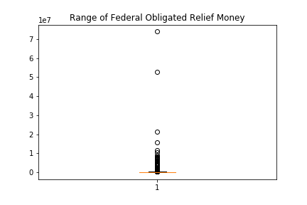
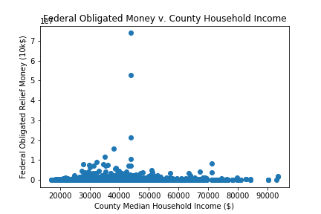
Two Counties were outliers in our data
These were removed for our analysis

Slide 8
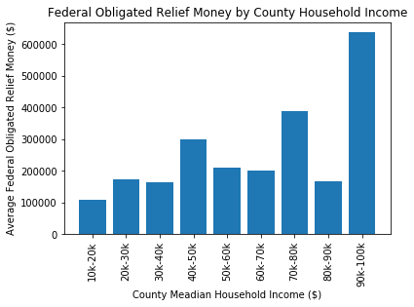
Income Data was grouped by $10k and Compared to their Relief Data
Chi Squared analysis on these groups provided a p value of less than 0.00001.

Slide 9
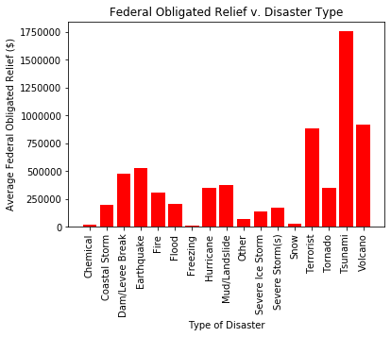
Are Certain Disaster Types More Expensive?
A one-way ANOVA test was performed giving a pvalue of .0002. This shows that there is a very strong likelihood that some disasters are stronger than others.

Slide 10
The Takeaway
Initial Analysis would show that there is a significant difference between the relief aid given by FEMA to the lowest and highest income groups ($10k -$20k & $90k-100k).
In terms of Disaster Cost by type Tsunamis were the most costly by far.

Slide 11
Moving Forward
We would want to further investigate which type of disasters are hitting which counties and see how that compares to the FEMA data
We would want to also find data on the level of infrastructure in a county and it’s value to see it’s effect on our analysis.
From this analysis we would like to further examine county data based on racial and ethnic distribution to see if that is also playing a role in the distribution of FEMA aid.

